Slide 1

ZNF768 ChIP-seq analysis
Christophe TAV
BILODEAU LAB
UPDATE
FEBRUARY 27th, 2025

Slide 2


Slide 3
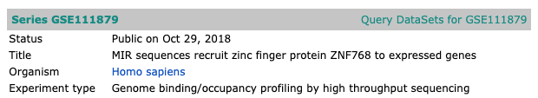
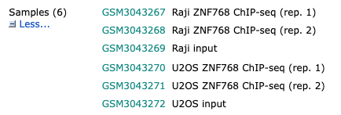
Series GSE111879
https://www.ncbi.nlm.nih.gov/geo/query/acc.cgi?acc=GSE111879
> 2 replicates per cell line

Slide 4
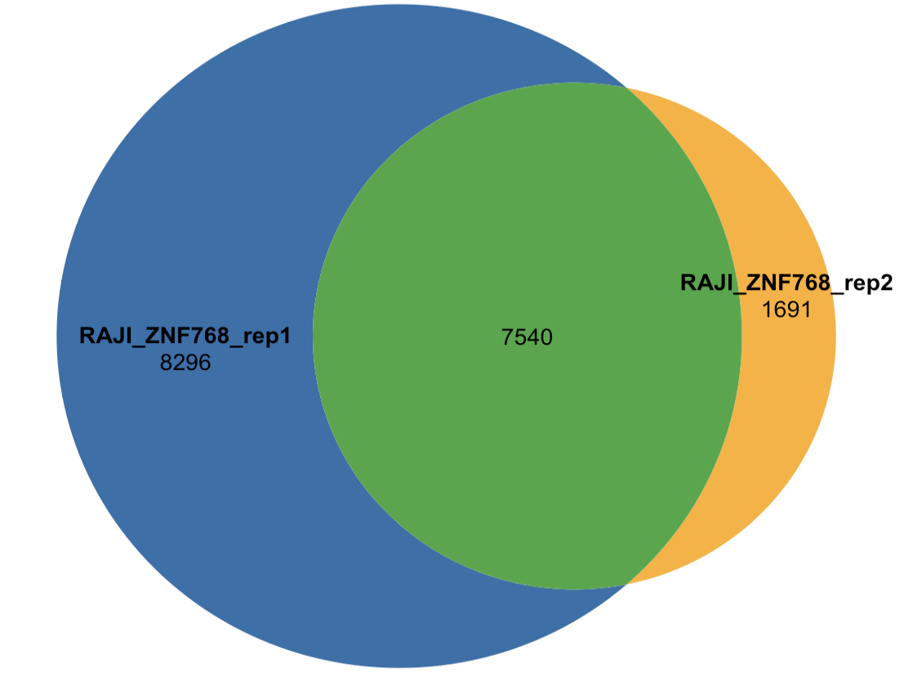
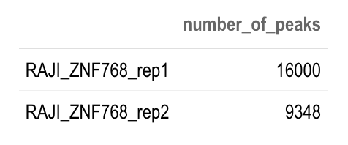
Raji
> great consistency between replicates

Slide 5
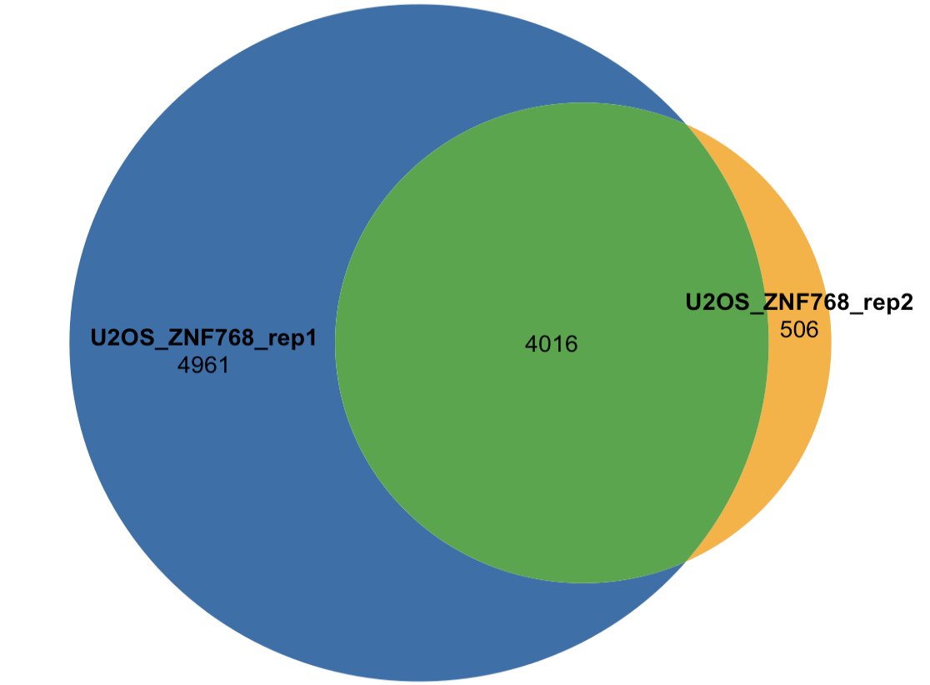
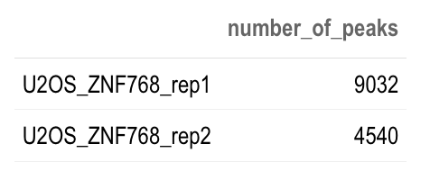
U2OS
> great consistency between replicates

Slide 6
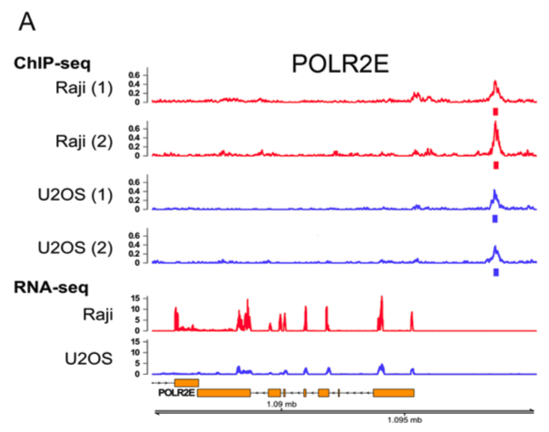
Fig6A: POLR2E
Rohrmoser et al., Nucleic Acids Research, 2019

Slide 7
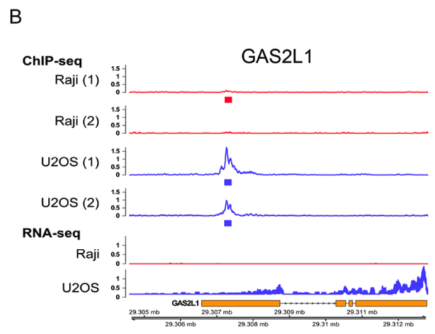
Fig6B: GAS2L1
Rohrmoser et al., Nucleic Acids Research, 2019

Slide 8
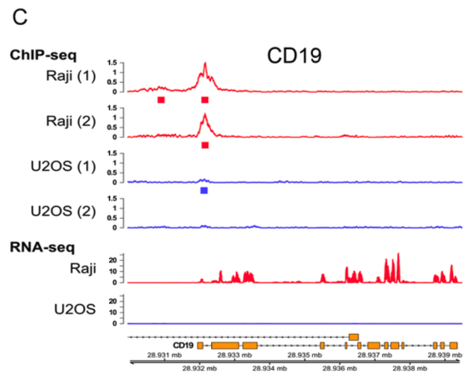
Fig6C: CD19
Rohrmoser et al., Nucleic Acids Research, 2019

Slide 9
E2F1

Slide 10
UCSC Tracks
a link to UCSC Tracks will be available soon
(once the server error is resolved)
RAJI_ZNF768_rep1
RAJI_ZNF768_rep2
RAJI_ZNF768_pooled
U2OS_ZNF768_rep1
U2OS_ZNF768_rep2
U2OS_ZNF768_pooled

Slide 11
XXX

